Slide 1

プロ野球Freak
22vr039t Sunggon Park

Slide 2

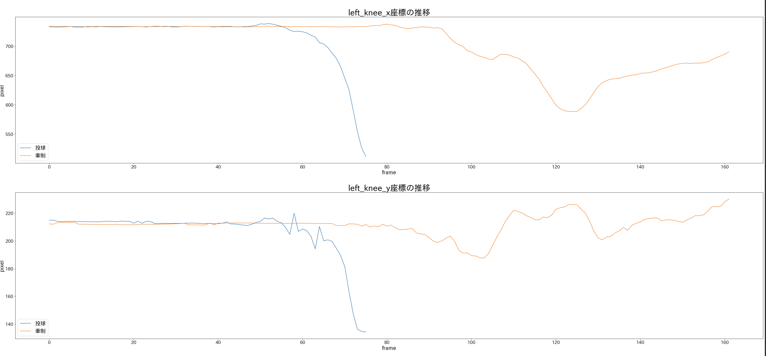
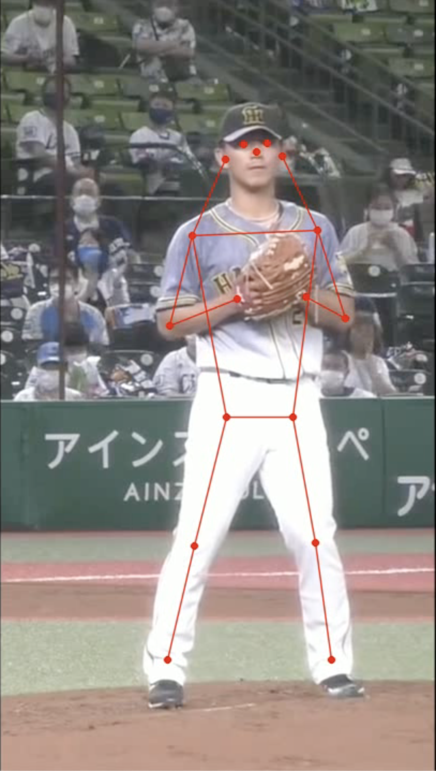
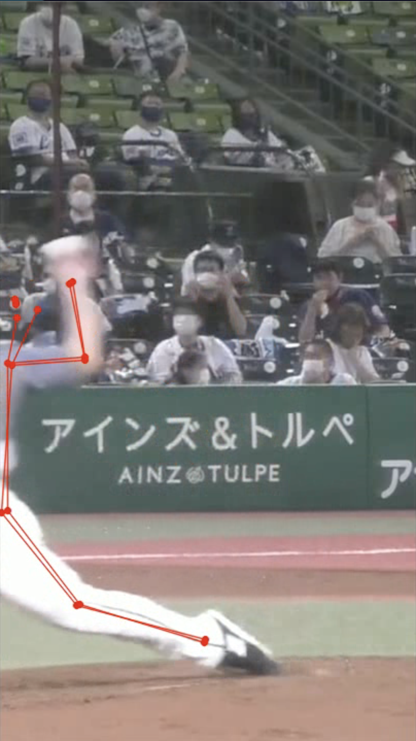
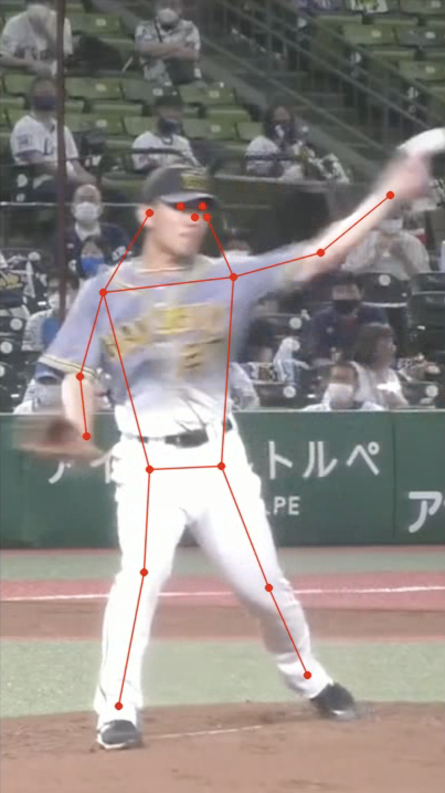

データの選択
セットアップ時
投球時のリリースタイミング
牽制時のリリースタイミング
分析結果
Data/Domain知識

Slide 3
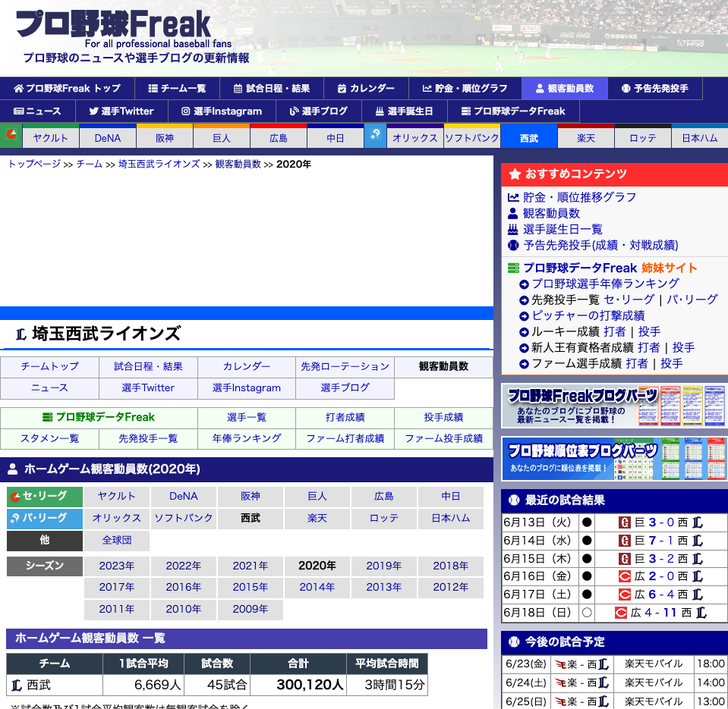
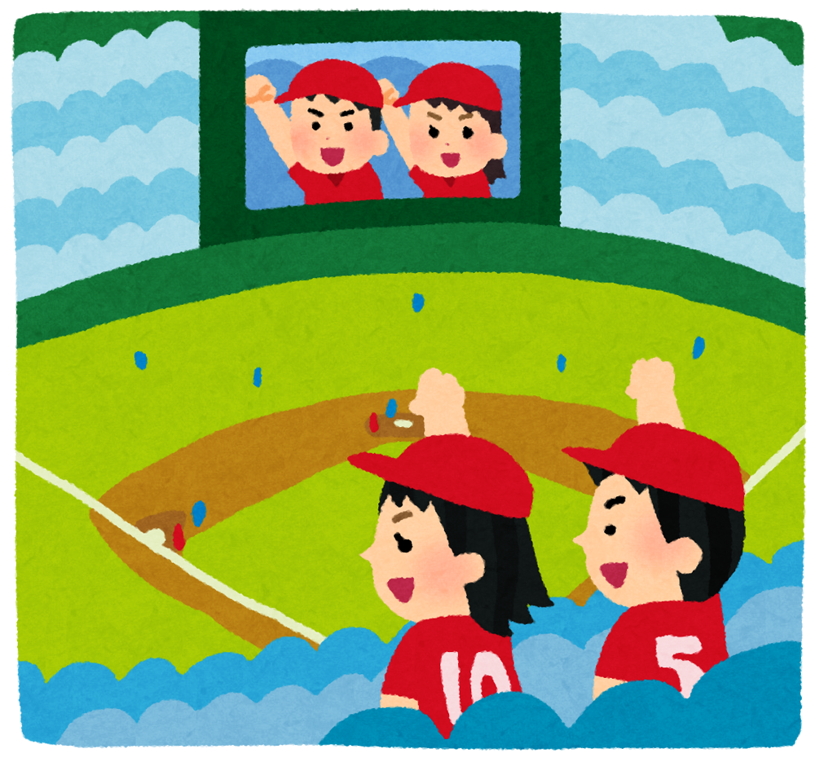
問題設定
2009年から2022年までの日付や対戦相手など5-6の指標 (説明変数)を元に ホームゲームの観客数を予測する回帰モデルを作り、重要な指標を理解する。
https://baseball-freak.com/audience/22/lions.html

Slide 4
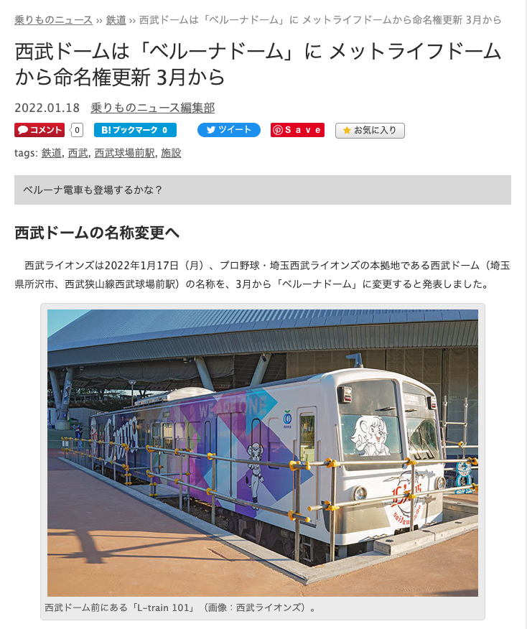
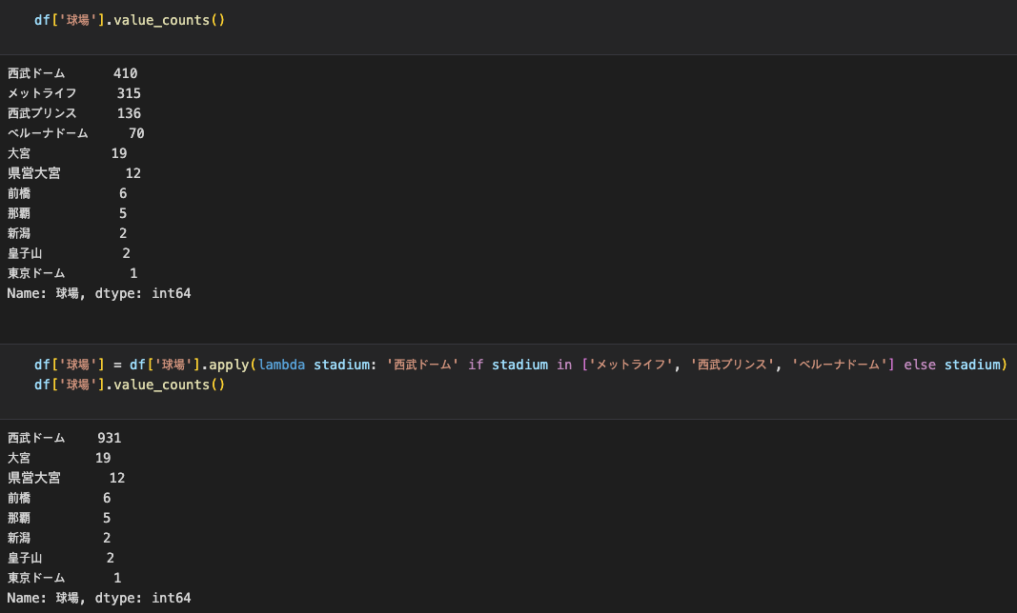
データの前処理と可視化
https://trafficnews.jp/post/114558

Slide 5
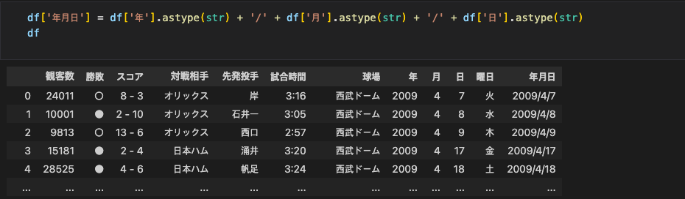
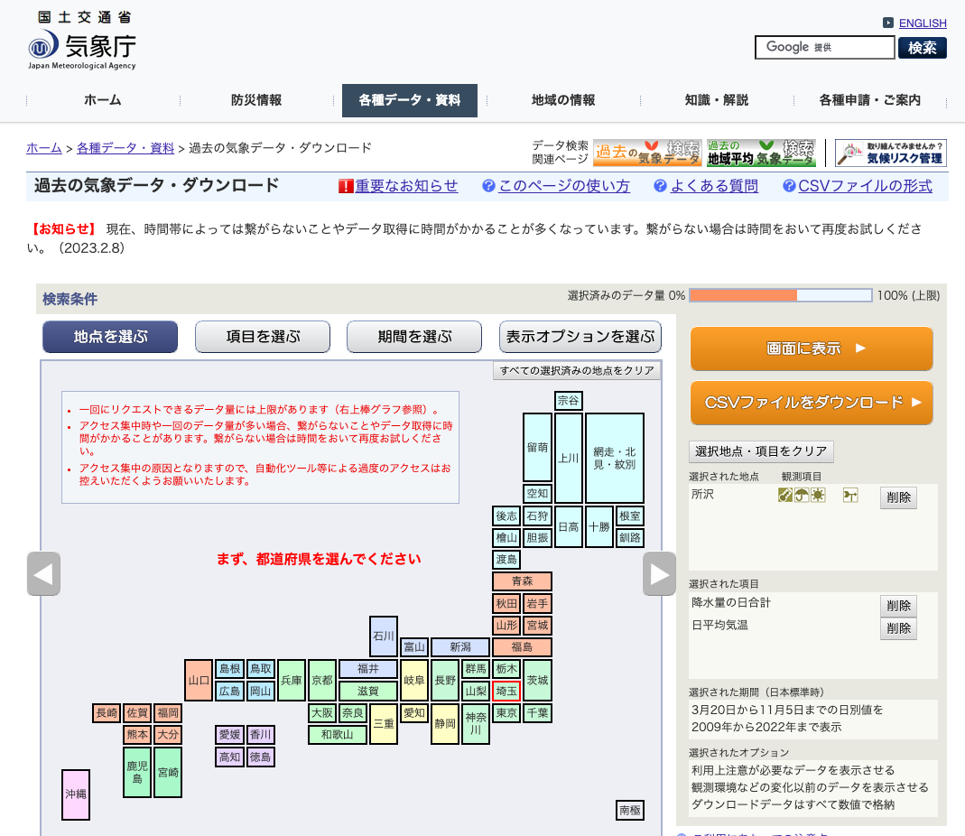
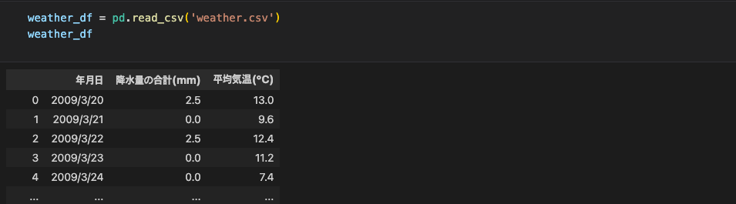
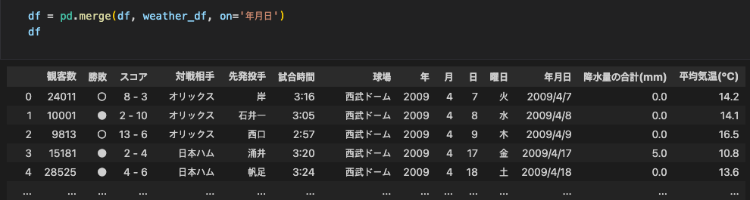
データの前処理と可視化
https://www.data.jma.go.jp/gmd/risk/obsdl/index.php

Slide 6
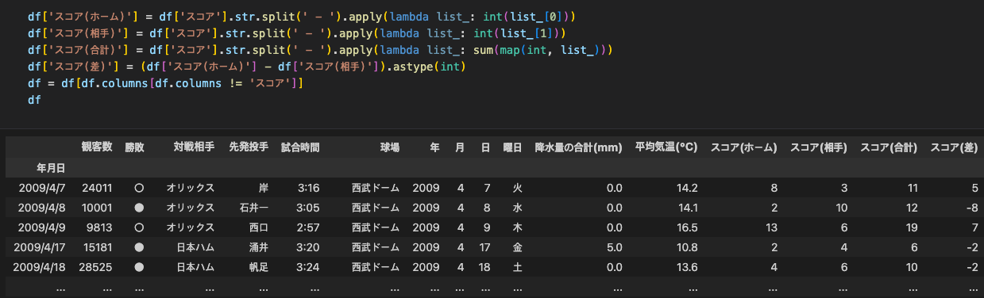
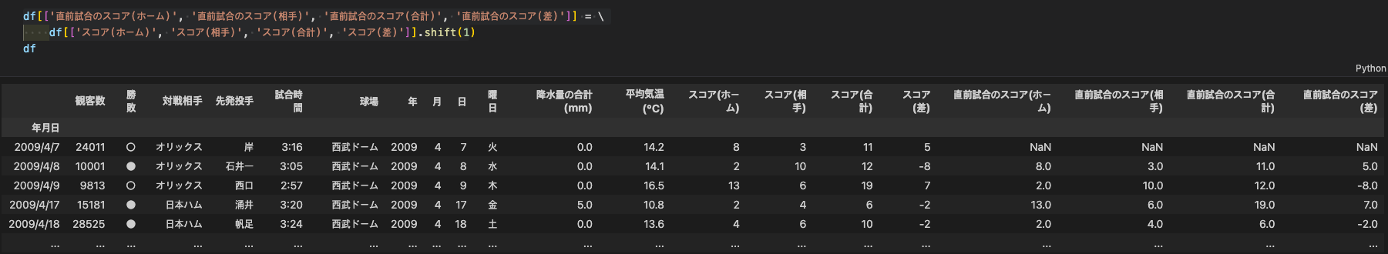
データの前処理と可視化

Slide 7
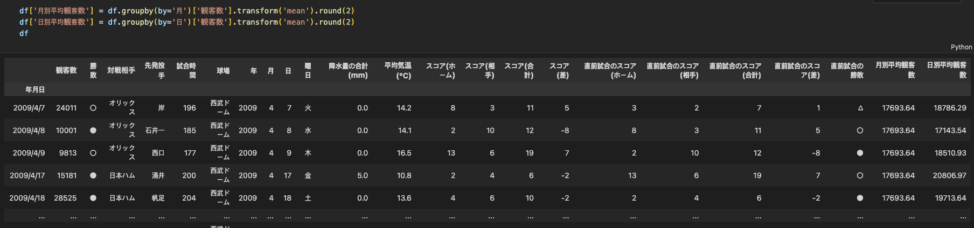
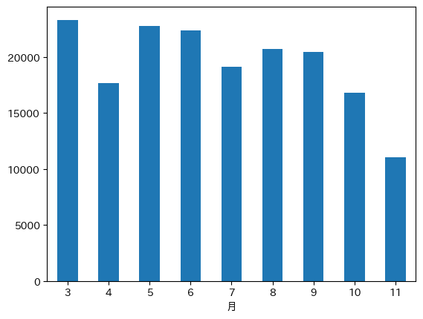
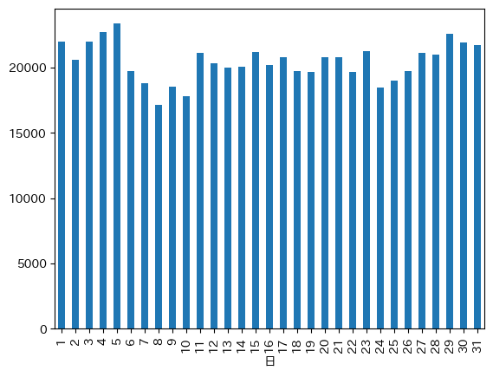
データの前処理と可視化

Slide 8
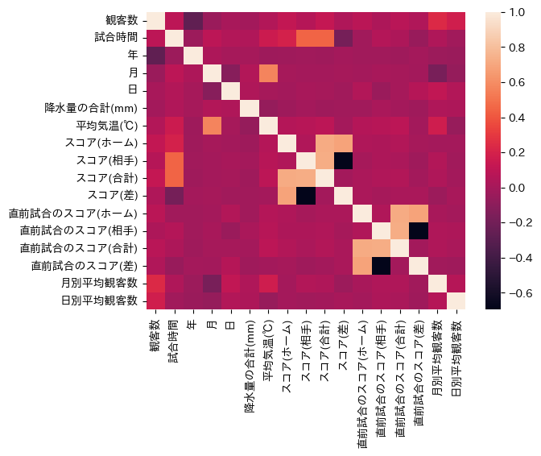
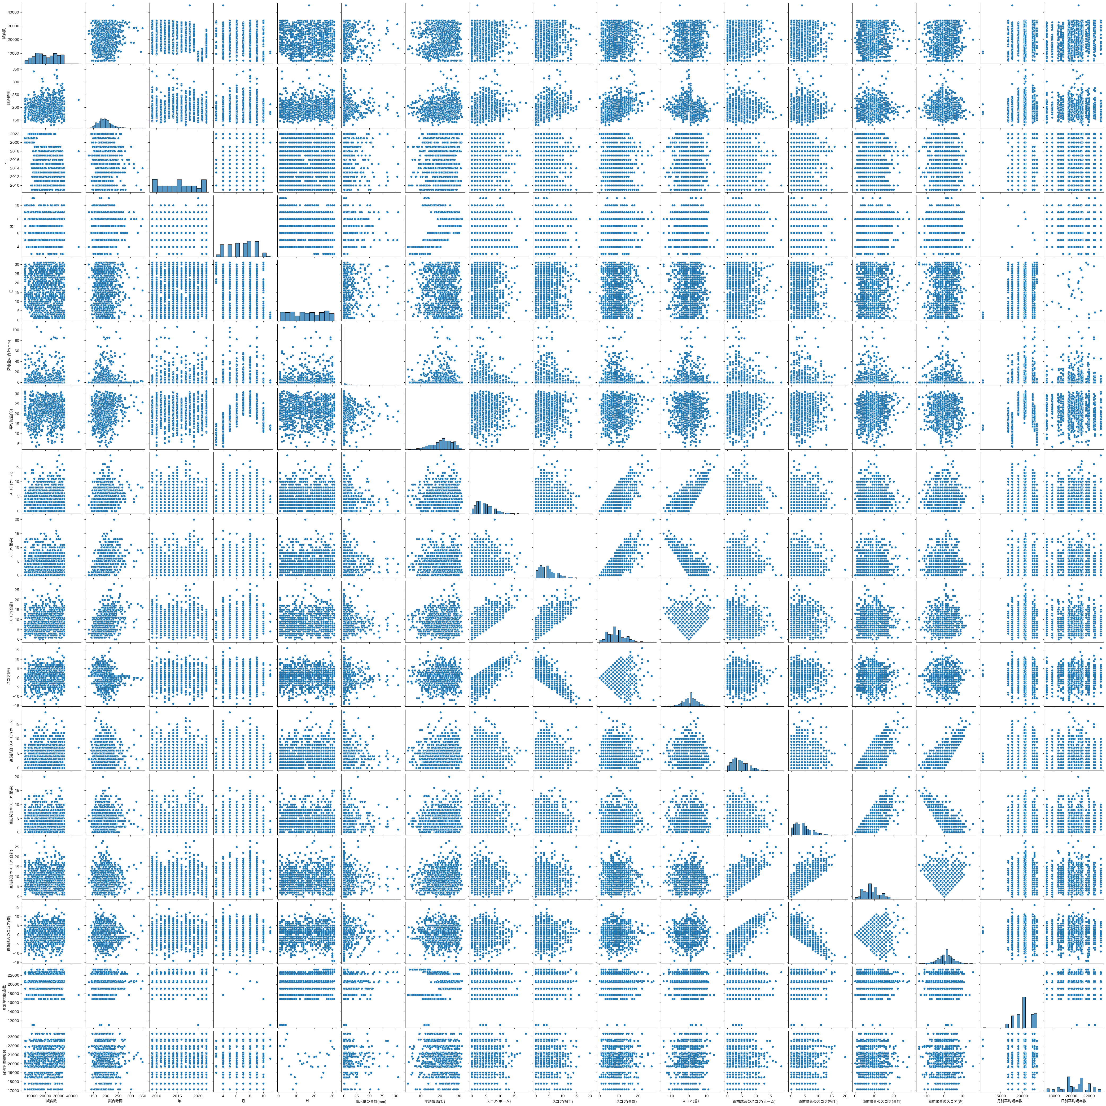
データの前処理と可視化
HeatMap ヒートマップ
PairPlot 散布図行列

Slide 9
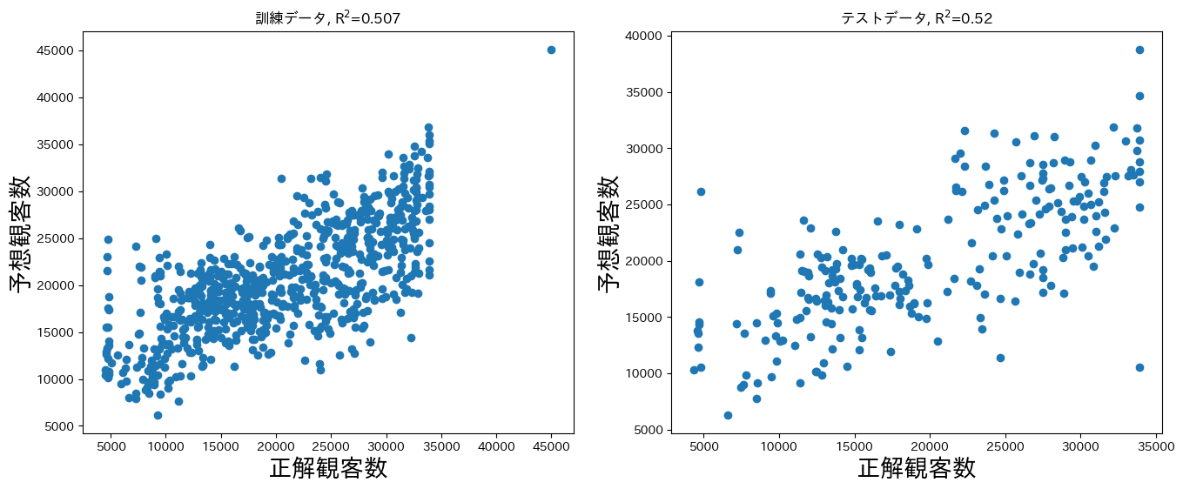
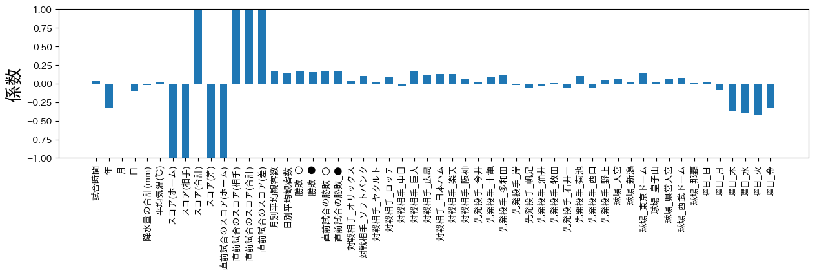
分析と重要指標理解 (LinearRegression as a Base Model)

Slide 10
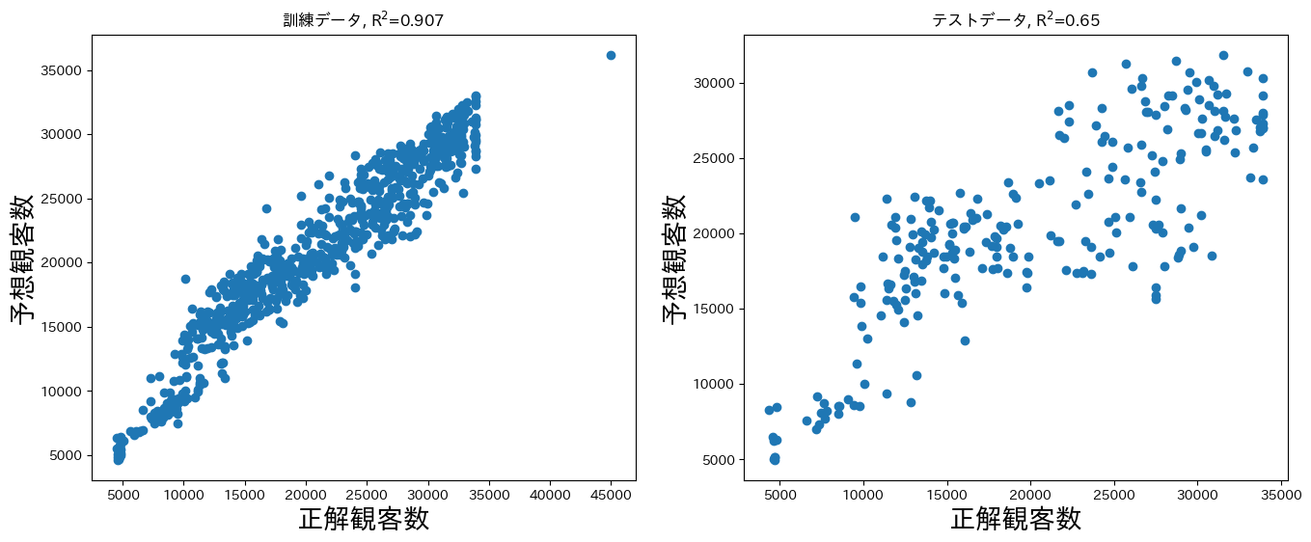
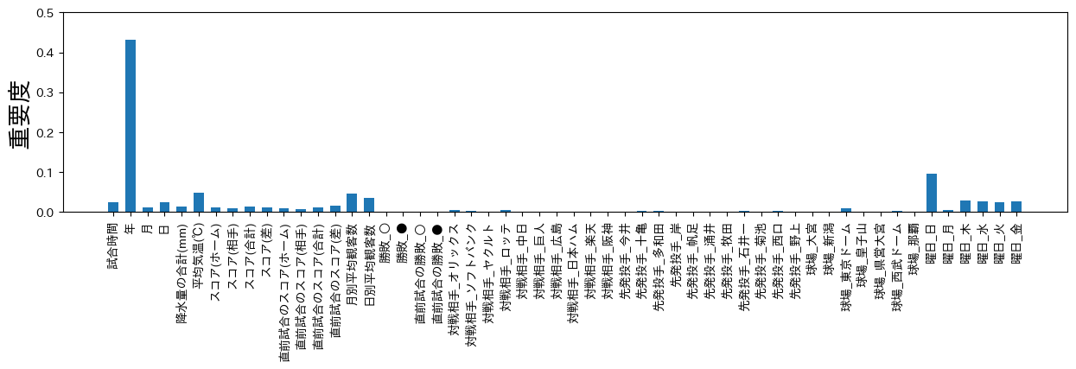
分析と重要指標理解 (RandomForest with GridSearchCV)

Slide 11
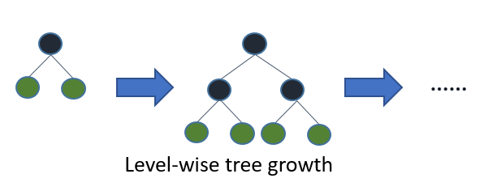
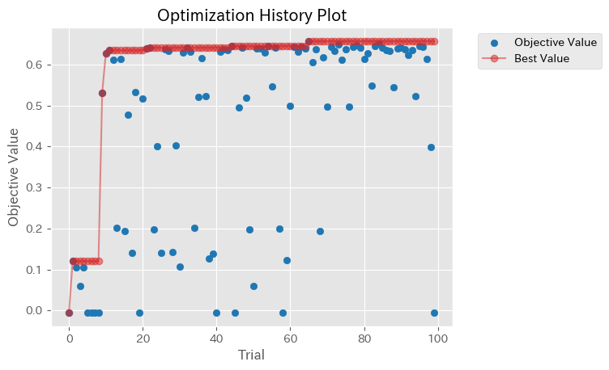
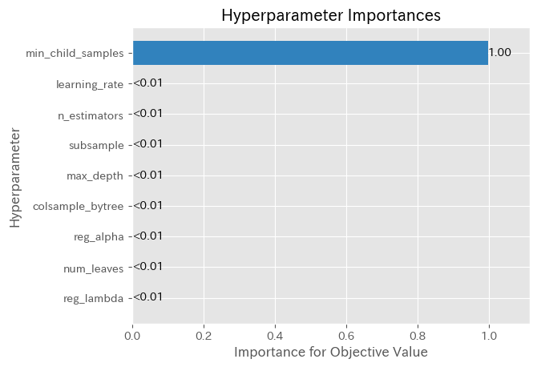
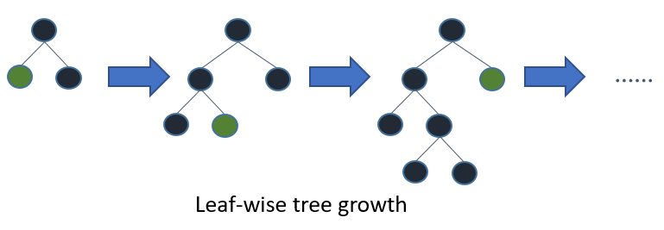
分析と重要指標理解 (LightGBM with Optuna)
LightGBM: A gradient boosting framework that uses tree-based learning algorithms
Faster training speed and higher efficiency
Lower memory usage
Better accuracy
Support of parallel, distributed, and GPU learning
Capable of handling large-scale data
Optuna: A hyperparameter optimization framework that employs Bayesian optimization algorithms
Lightweight, versatile, and platform agnostic architecture
Pythonic search spaces
Efficient optimization algorithms
Easy parallelization
Quick visualization
Most decision tree learning algorithms
LightGBM
https://lightgbm.readthedocs.io/en/stable/Features.html
https://optuna.readthedocs.io/en/stable/index.html

Slide 12
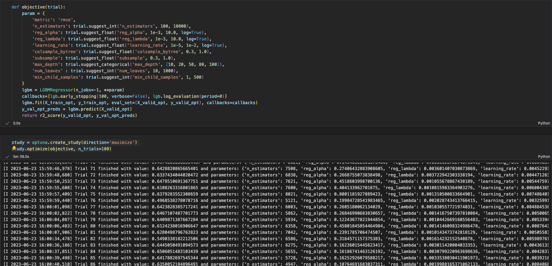
分析と重要指標理解 (LightGBM with Optuna)

Slide 13
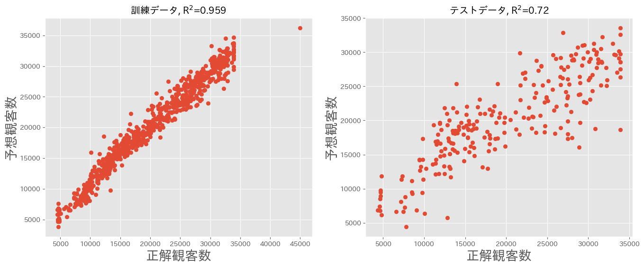
分析と重要指標理解 (LightGBM with Optuna)

Slide 14
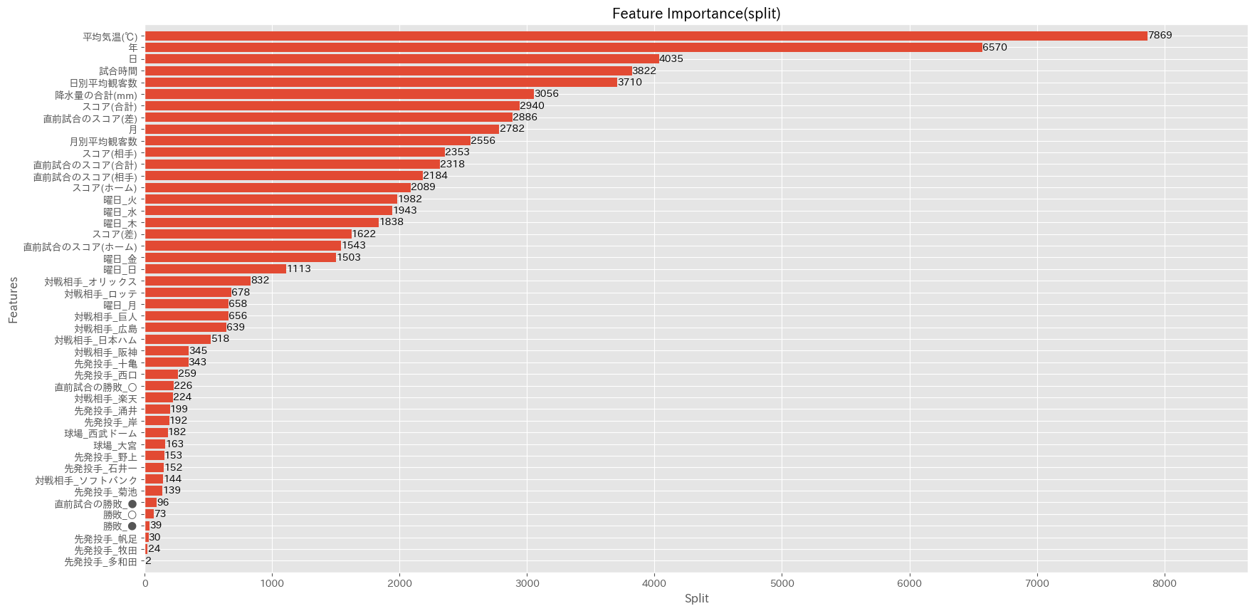
分析と重要指標理解 (LightGBM with Optuna)
Split: result contains numbers of times the feature is used to split the data across all trees.

Slide 15
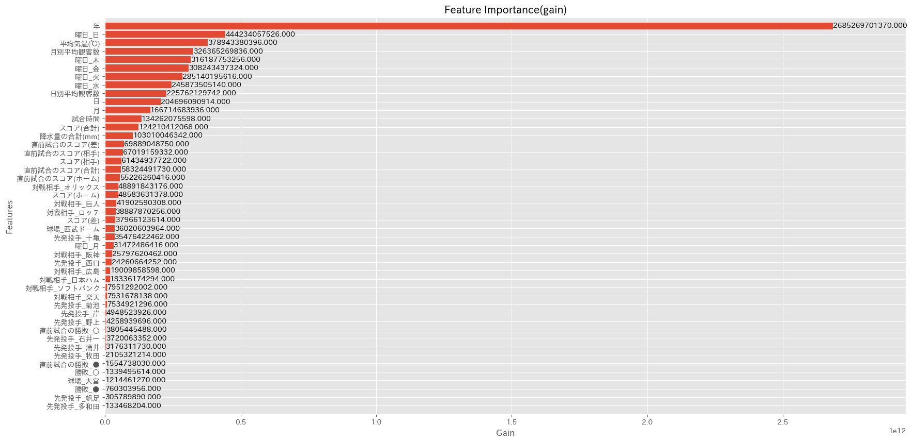
分析と重要指標理解 (LightGBM with Optuna)
Gain: result contains the average training loss reduction gained when using a feature for splitting.

Slide 16
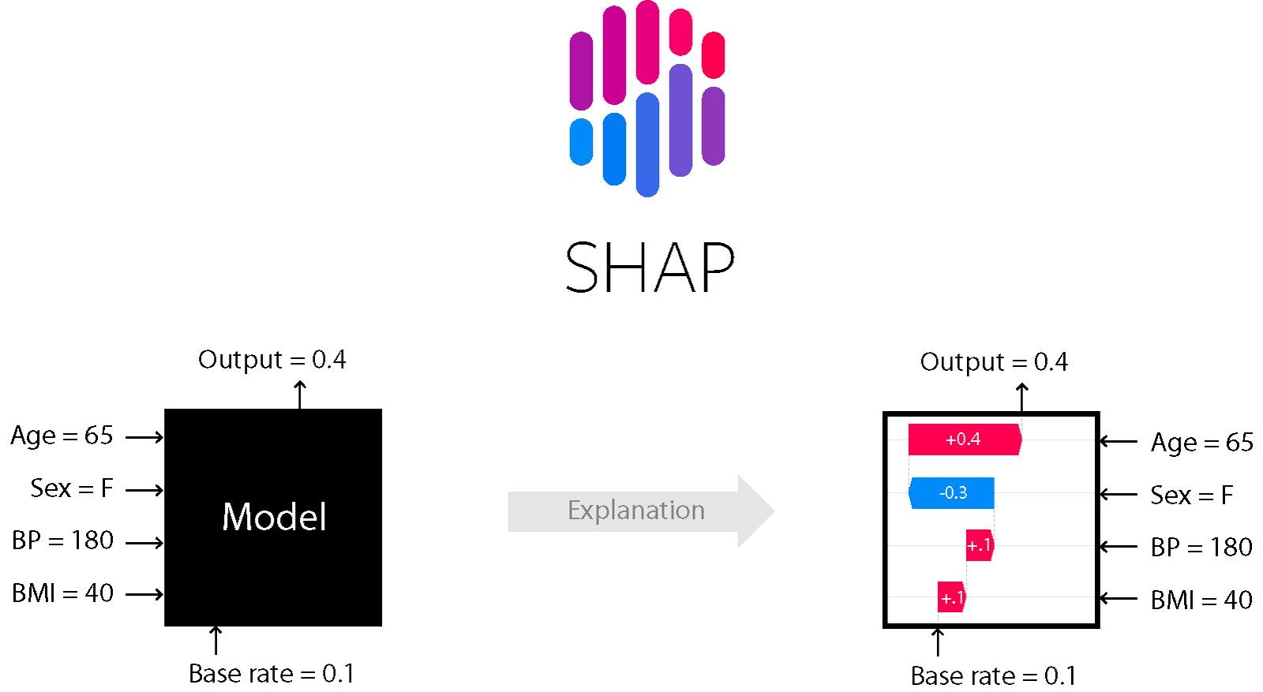
分析と重要指標理解 (SHAP)
What makes a measure of feature importance good or bad?
1. Consistency
- Whenever we change a model such that it relies more on a feature, then the attributed importance for that feature should not decrease.
2. Accuracy
- The sum of all the feature importances should sum up to the total importance of the model. (For example if importance is measured by the R² value then the attribution to each feature should sum to the R² of the full model)
SHAP is both consistent and accurate.
https://towardsdatascience.com/interpretable-machine-learning-with-xgboost-9ec80d148d27

Slide 17
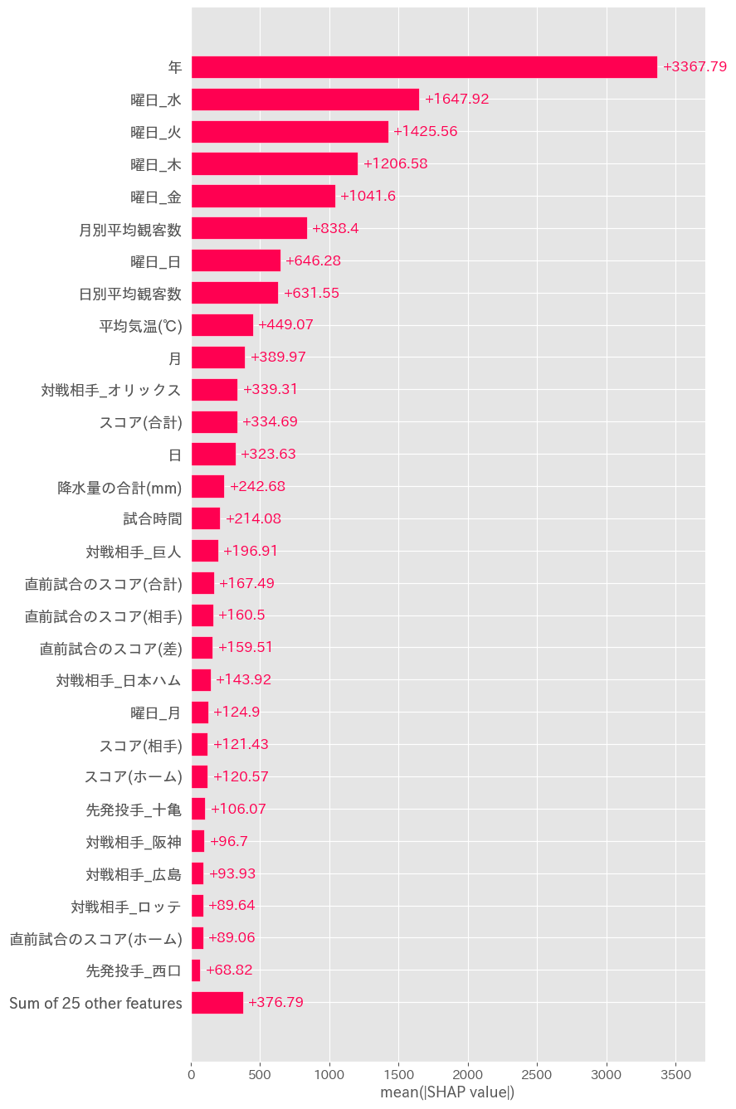
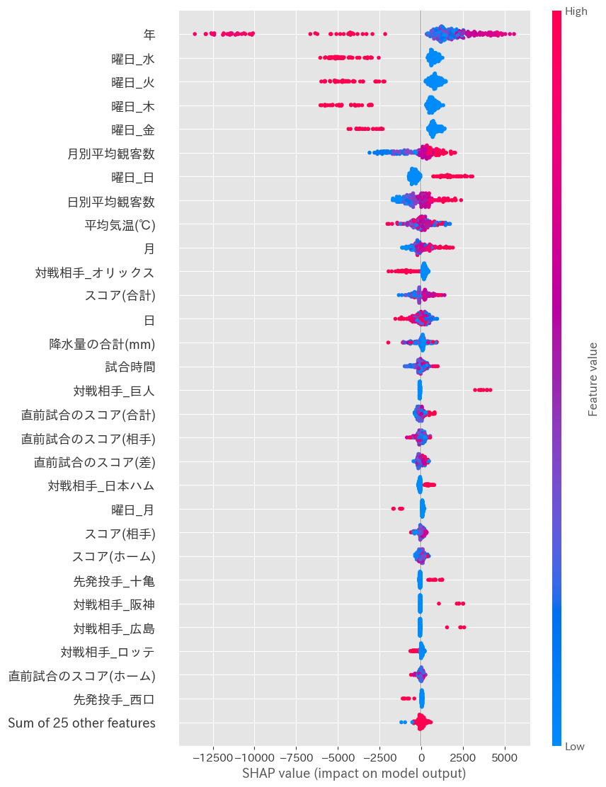
分析と重要指標理解 (SHAP)

Slide 18
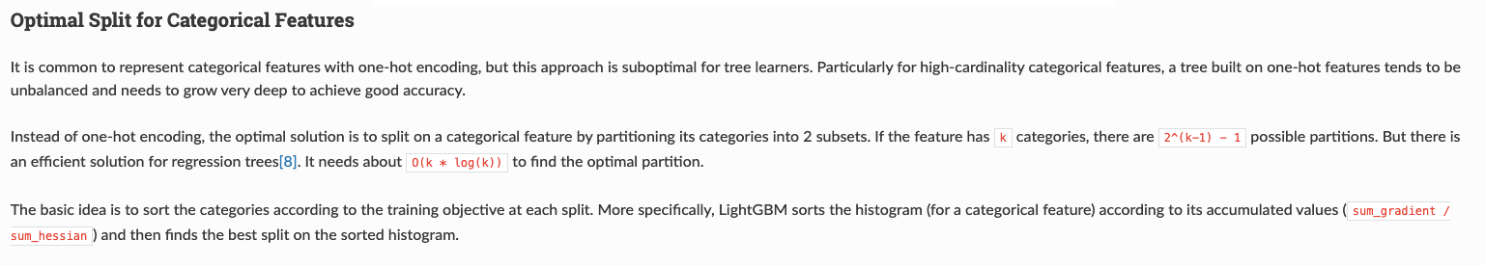
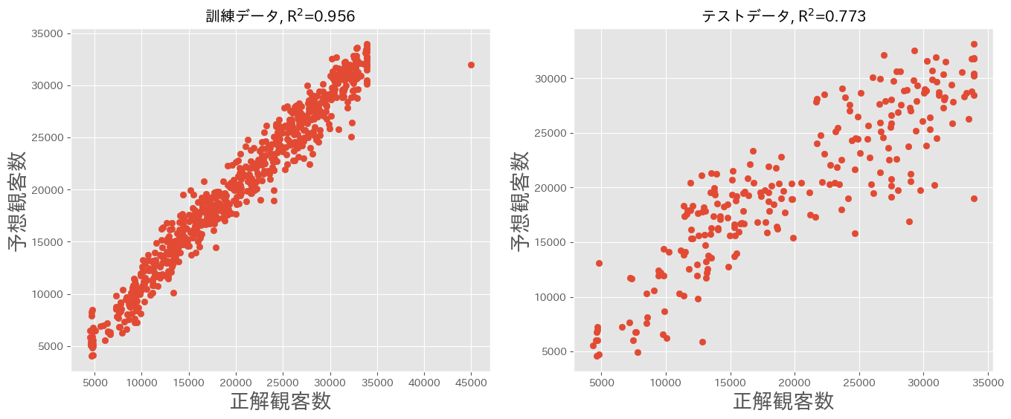
https://lightgbm.readthedocs.io/en/latest/Features.html#optimal-split-for-categorical-features
Lightgbm without one hot encoding using categorical feature support

Slide 19
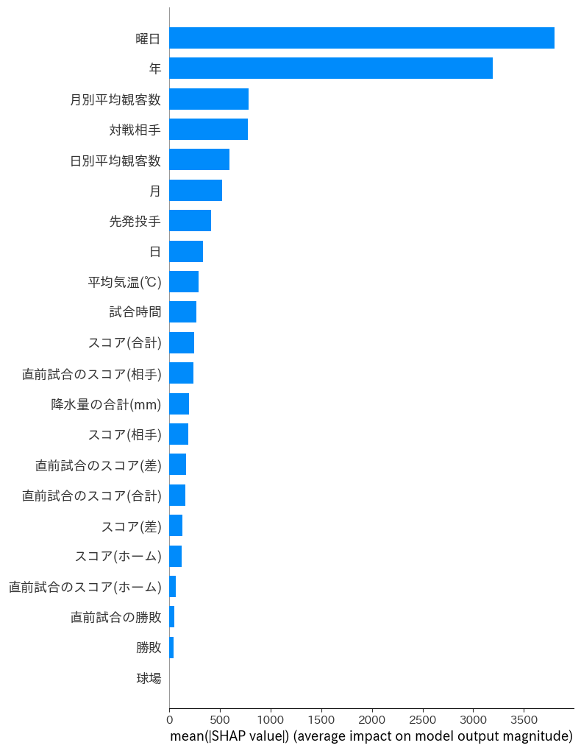
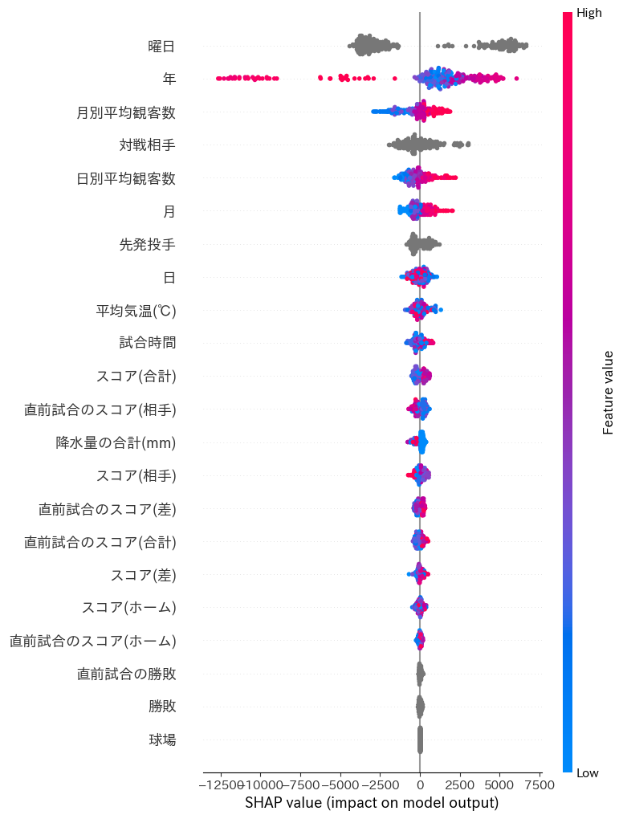
Lightgbm without one hot encoding using categorical feature support

Slide 20
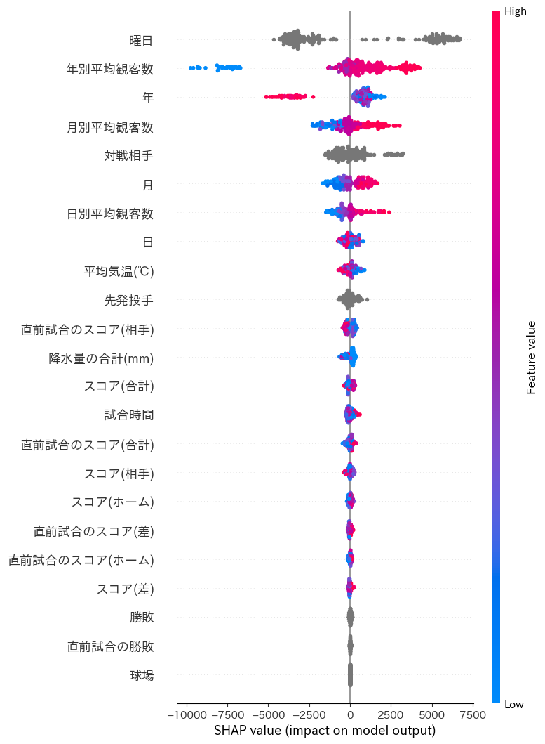
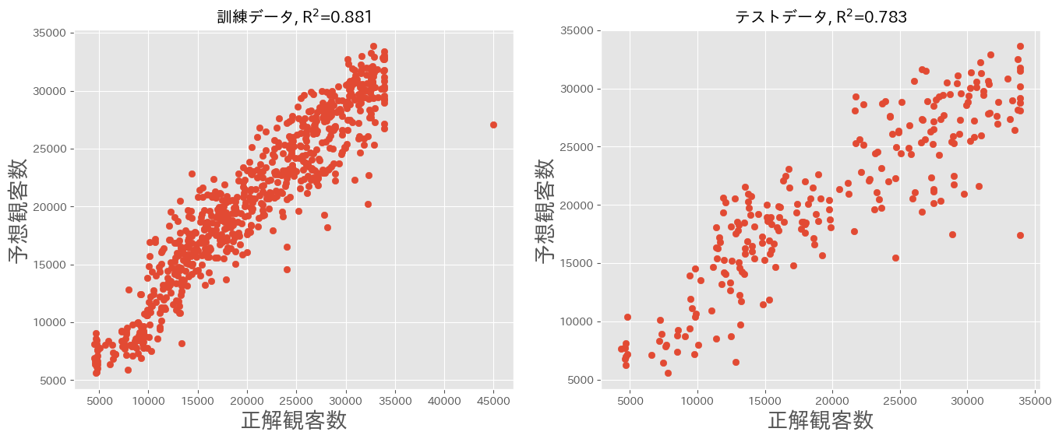
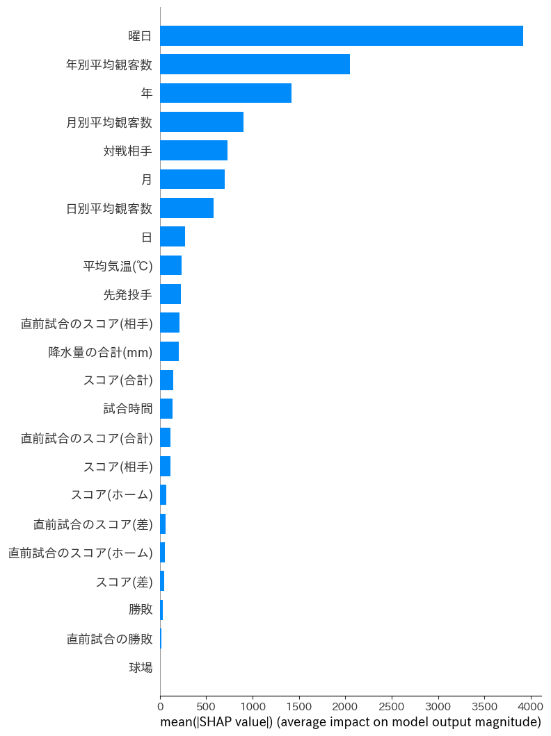
年別平均観客数特徴量の追加

